Slide 1

AR-Miner: Mining Informative Reviews for Developers from Mobile App Marketplace
Presented by Chen Ning
Nanyang Technological University, Singapore
June, 2014

Slide 2
Agenda
Background & Motivation
Problem Setting
Framework&
Evaluation
Open Question& Conclusion
1
2
3
4

Slide 3

Background
About 1.5 million apps on Apple App Store*
About 1.2 million apps on Google Play^{Ϯ}
About 300, 000 active publishers (developers) in the US Apple App Store*
App Developers Face
Intense Competition !
* Based on http://148apps.biz/app-store-metrics/
Ϯ Based on http://www.appbrain.com/stats/number-of-android-apps

Slide 4
Background (Cont.)
Delivery & Feedback
Iteration
Planning
Implementation
Iterative process to develop, test and maintain apps.
Effectively and Efficiently extract feedback from users is crucial.

Slide 5



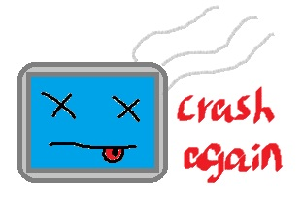
Typical Channels
Bug/Change Tracking System
Online Forum
Email
Crash Reporting
Feedback usually (i) has higher quality; (ii) is better organized.

Slide 6
New Channel: User Reviews in App Markets
Web-based
market portal
Market app
User reviews present feedback on various aspects of apps, e.g., functionality, quality, performance, etc.
We refer to reviews as “informative” if they contains information that is useful for developers improving the quality of apps.

Slide 7




Challenges
Challenge 1: The proportion of “informative” user reviews is relatively low.
SwiftKey Keyboard
29.3%
Facebook
55.4%
35.1%
Temple Run 2
31.1%
Tap Fish
24.6%
Challenge 2: For hot apps, the volume of user reviews is too large.
~9000/day
~6000~/day

Slide 8
Agenda
Background & Motivation
Problem Setting
Framework&
Evaluation
Open Question& Conclusion
1
2
3
4

Slide 9
Informative vs. Non-informative
Functional flaw that produces incorrect or unexpected results
Performance flaw that degrades the performance of apps
Informative
Request to add/modify features
Requests to remove permissions
Requests to remove advertisements/notifications
Example: I would love to more themes, the current themes are great but I love customising my phone.
Example: It won't let me delete comments made by others that I would like to delete.
Example: This game is adding too much unexplained permissions.

Slide 10
Informative vs. Non-informative (Cont.)
Pure user emotional expression
Description of (apps, features, actions, etc.)
Non-informative
Too general/unclear expression of failures and request
Questions and inquires
Example: This is a really great program I love it.
Example: I just installed the app and wanted to enjoy it.

Slide 11
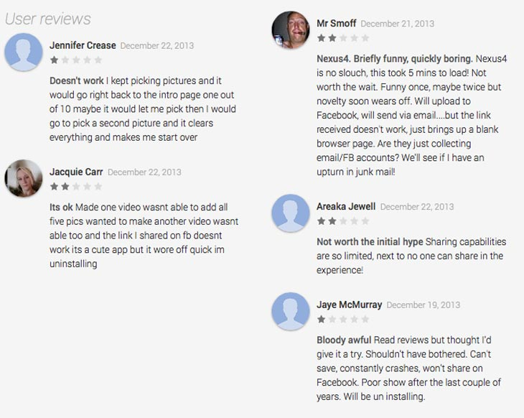
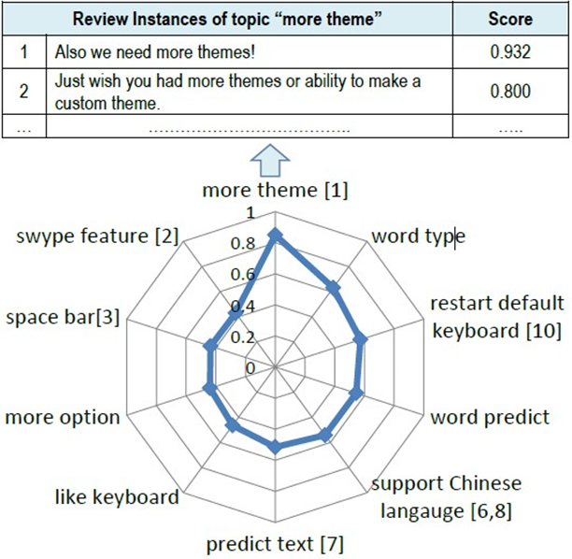
The Problem Statement
A bunch of user reviews of an app collected during a certain time interval.
An intuitive summarization of the most “informative” feedback users have.
An important problem
in bug/requirement
engineering

Slide 12
Agenda
Background & Motivation
Problem Setting
Framework&
Evaluation
Open Question & Conclusion
1
2
3
4

Slide 13
AR-Miner Framework
Pre-processing
Ranking
Visualization
Filtering
Grouping
1
2
3
4
5

Slide 14
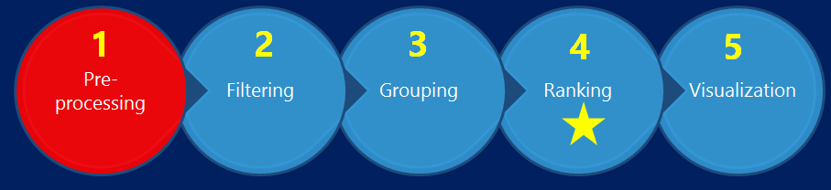

(1) Pre-processing
Attribute set = {Text, Rating, Timestamp}
Split Text into several sentences
Tokenization, lowercase, stemming, etc.

Slide 15
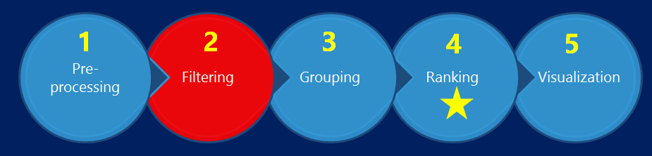

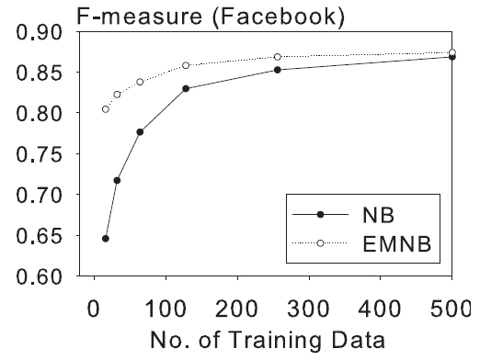
(2) Filtering
Train a classifier on historical data to automatically filter out “non-informative” reviews.
Adopt a semi-supervised machine learning algorithm, i.e., Expectation Maximization for Naïve Bayes (EMNB).
Dataset | Facebook
Train pool | 1000
Unlabeled | 104709
Test set | 2000

Slide 16
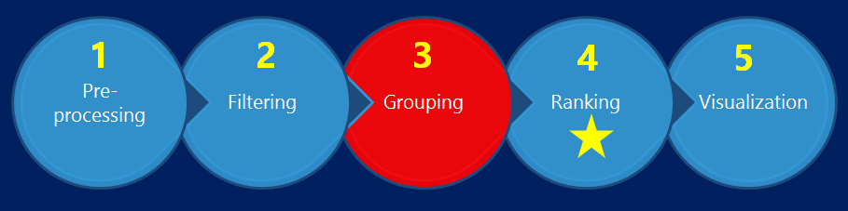
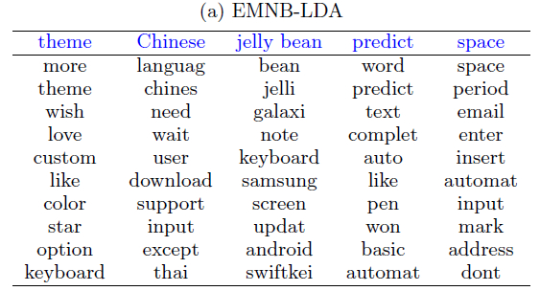
(3) Grouping
Partition the predicted “informative” reviews into groups (topics).
Adapt Latent Dirichlet Allocation (Topic Modelling).
Dataset | SwiftKey
Train pool | 1000
Unlabeled | 3282
Test set | 2000

Slide 17
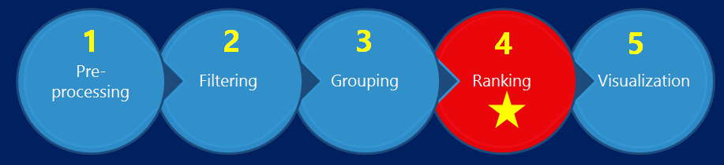
(4) Ranking
Topic 1
Review 1
Review 2
…
Topic 2
Group Score (g): Linear combination of various importance measures on features of groups.
Instance Score (i): Linear combination of various importance measures on features of individual reviews.
Topic 3
…

Slide 18
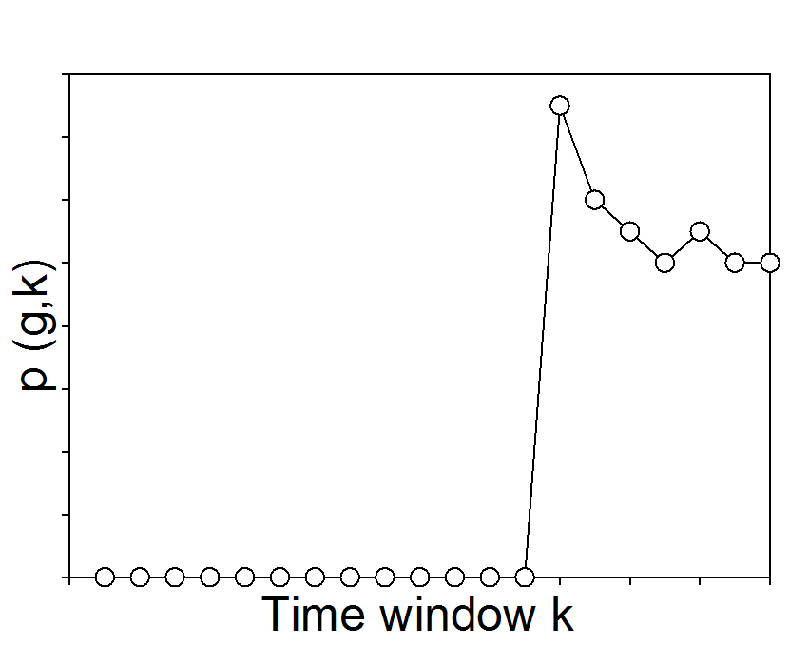
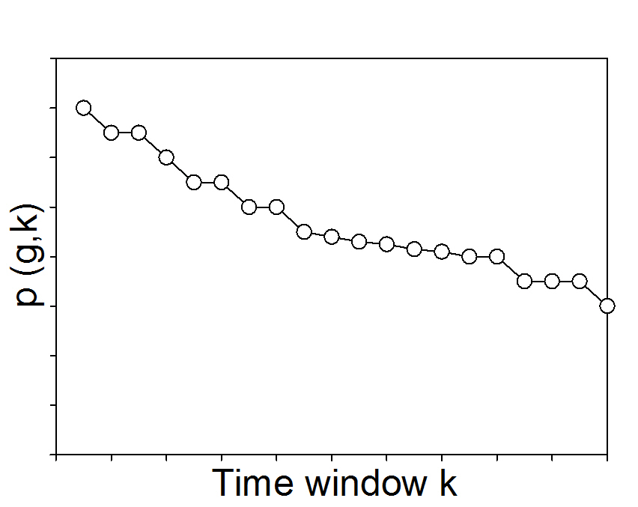
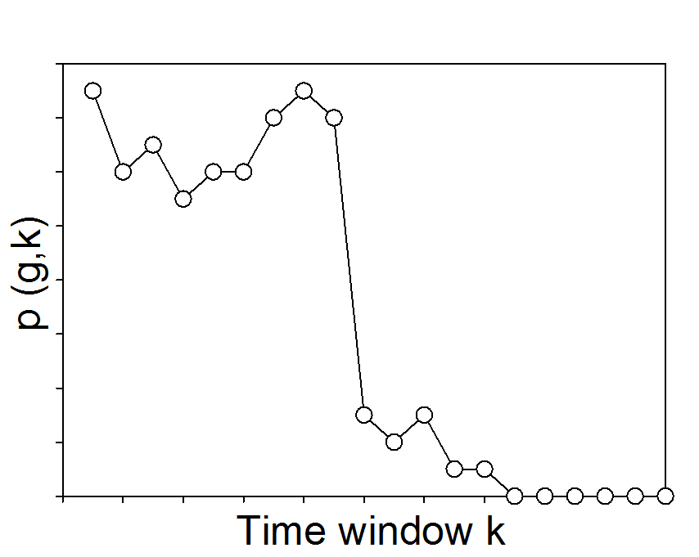
(4-1) Group Ranking
Volume
Average Rating
Time Series Pattern
Larger volume means it is more important.
Lower average rating means it is more important.
Fresher indicates it is more important.

Slide 19
(4-2) Instance Ranking
Proportion
Duplicates
Rating
Larger proportion means it is more important.
More duplicates means it is more important.
Lower rating means it is more important.
Timestamp
Probability
More fresher means it is more important.
Large probability means it is more important.

Slide 20
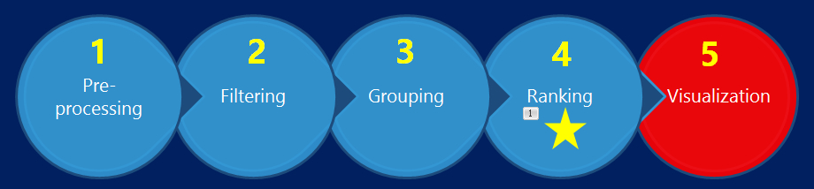
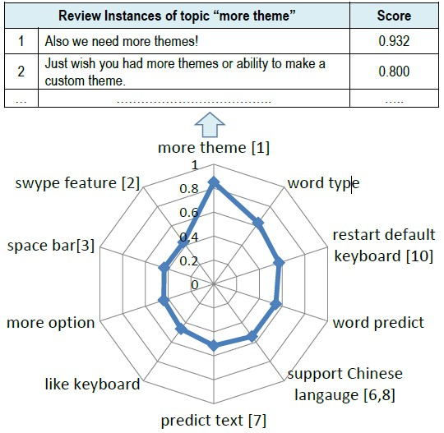
(5) Visualization
A radar chart which depicts the GroupScore value of each group (topic).
Each group is labeled by two or three top probability words within the group.
The GroupScores decrease in the clockwise direction.

Slide 21
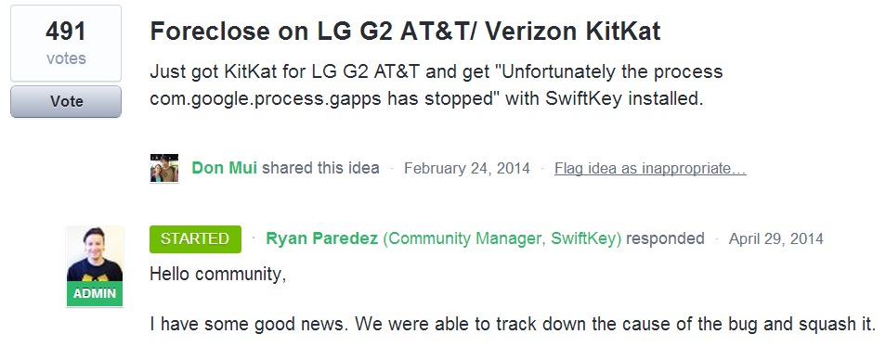

Case Study
SwiftKey Keyboard
App developers created a nice forum¹ to collect user feedback.
Get a comparable ranking list of “informative” information.
Top-10 ranked feedback list in the decreasing order of number of votes (ground truth).
1. http://support.swiftkey.net/

Slide 22
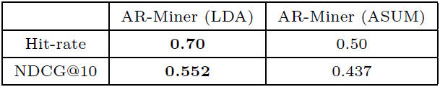
Case Study (Cont.)
6282 reviews collected from Google Play in a three months period.
Compare the ranking results attained by AR-Miner with the ground truth.
Beneficial for app developers, especially who have not established valid channels.

Slide 23
Agenda
Background & Motivation
Problem Setting
Framework&
Evaluation
Open Question & Conclusion
1
2
3
4

Slide 24

Open Question
1. The definition of “informative” and “non-informative” is not absolutely correct, and could be further improved and refined.
Binary Classification
Multiclass Classification
2. Every step of AR-Miner can be improved to achieve better performance.
Filtering
Visualization
Further reduce human efforts in labeling training data
Better visualization, more intuitive to developers.

Slide 25
Open Question (Cont.)
3. Explore other ranking schemes.
Explore more features of user reviews for ranking
Learning the optimum weights for the ranking function
Incremental ranking adapted to streaming user reviews
4. Empirical evaluation on other app marketplaces, e.g., Apple App Store

Slide 26
Conclusion
1. We formulate a new problem that aims to discover the most “informative" information from raw user reviews in app markets for developers to improve their apps;
2. We present AR-Miner as a novel analytic framework to tackle this new and challenge problem.
3. We summarize several open question in the future work.

Slide 27
Thank you !
Contact: hzzjucn@gmail.com

